Slide 1
Data Models
Pravin Y Pawar
Adapted from Designing Machine Learning Systems by Chip Huyen

Slide 2
Structured vs Unstructured data
Structured data
Follows a predefined data mode – aka schema
For example, Person model has two data values, age of type number and name as string
Predefined structure makes data analysis easier
Disadvantage – commitment to predefined schema!
If schema changes, retrospectively update all data – causes mysterious bugs in the process
As requirements changes over time,
Committing to a predefined schema can be restricting
If data coming from multiple sources, don’t have any control over schema
Unstructured data becomes appealing!

Slide 3
Structured vs Unstructured data(2)
Unstructured data
Does not adhere to predefined schema!
Usually a text but can also be numbers, dates, images, audio
Might still contain intrinsic patterns that helps to extract meaningful structures out of data
Allows for more flexible storage options
If storage follows schema, can only store data following that schema
If storage does not follows schema, can store any type of data!
Can convert all data, regardless of types and formats into byte strings and store them together
Data Warehouse vs Data Lake
Data warehouse is repository to store structured data
Data Lake is repository to store unstructured data
Data lakes are usually used to store raw data before processing
Data warehouses are used to store data that has been processed into formats ready to be used

Slide 4
Structured vs Unstructured data(3)
Key Differences
Structured data | Unstructured data
Schema already defined | Does not have to follow a schema
Easy to search and analyze | Fast arrival
Can only handle data with a specific schema | Can handle data from any source
Schema changes will cause a lot of troubles | No need to worry about schema changes, as its shifted to the downstream applications that uses this data
Stored in data warehouses | Stored in data lakes

Slide 5
Data Models
Most important part of developing software, because they have such a profound effect
on how we think about solving the problem
on how the software is written
Describes how data is represented in terms of attributes
Car can be represented by its make, model, year, color etc., as well by its owner, license plate etc.
Most applications are built by layering one data model on top of another
Many different kinds of data models
Every data model embodies assumptions about how it is going to be used
Building software is hard enough, even when working with just one data model, and without worrying about its inner workings
Selecting a data representation affects
the ways systems are built
The problems systems can solve

Slide 6
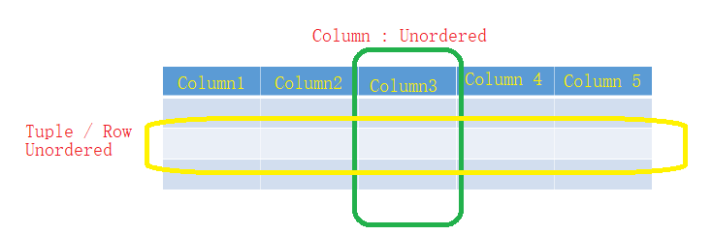
Relational Model
Most persistent ideas in computer science
Invented by Edgar Codd in 1970, but still going strong today, even getting more popular!
Simple and Powerful
Data is organized into relations; Each relation is a set of tuples
Table is visual representation of relation, each row of table makes up a tuple
Relations are unordered – can shuffle order of rows or columns
Usually stored in CSV or Parquet format

Slide 7
Relational Model(2)
Normalization
Desirable for relations to be normalized
Can follow forms such as first normal form (1NF), second normal form (2NF) etc.
Can reduce data redundancy and improve data integrity
For example, consider Books relation
Lot of duplicate data – publisher , country
If something change, needs to be reflected everywhere
If normalized, updates needs to be managed in single place
Title | Author | Format | PubID | Price
Book1 | Pawar | Paperback | 1 | 20
Book1 | Pawar | E-book | 1 | 10
Book2 | Pravin | Paperback | 2 | 30
Book3 | PYP | Paperback | 1 | 30
Book2 | Pravin | Paperback | 2 | 15
Title | Author | Format | Publisher | County | Price
Book1 | Pawar | Paperback | Press1 | UK | 20
Book1 | Pawar | E-book | Press1 | UK | 10
Book2 | Pravin | Paperback | NotedDraft | US | 30
Book3 | PYP | Paperback | Press1 | UK | 30
Book2 | Pravin | Paperback | NotedDraft | US | 15
PubID | Pulisher | Country
1 | Press1 | UK
2 | NotedDraft | US
Major downside : need to join data back from multiple tables – expensive for large tables!

Slide 8
Relational Model(3)
Querying
Databases built around relational data model are relational databases
Language used to specify data to be retrieved from database is query language
Most popular is SQL
SQL
Declarative query language – specify the output needed rather than steps needed to get it
Specify the pattern of data –
Tables from which data is needed
Conditions the results must meet
Transformations, such as joins, sort, group, aggregate
Database figures out how to provide those results
How to break query in parts
What methods to user execute each part of query
Order in which the parts needs to be executed

Slide 9
NoSQL
Need and Origin
Relational model generalizes a lot but still restrictive
Needs a strict schema – schema management is painful!
Per Couchbase 2014 survey, frustration with schema management is #1 reason for adoption of non relational databases
Latest movement against relational data model is NoSQL
Started as hashtag for meetup to discuss non-relational databases
Retroactively reinterpreted as Not Only SQL – many NoSQL data systems supports relational models
Two major types – Document and Graph model
Document model targets use cases where data comes in self-contained documents
Graph model targeting use cases where relationships between data items are common and important

Slide 10
NoSQL(2)
Document Model
Built around concept of “document”
Single continuous string, encoded as JSON, XML or binary format like BSON
Each document has a unique key that represents that document, which can be used to retrieve it
Collection of document analogous to table in relational database, document analogous to row
Can convert relation into a collection of documents
Collection of document much more flexible than table
All rows in table must follow same schema while documents in same collection can have different schemas
For example, a book can be represented as document as follows
{
“Title”: “Book1”,
“Author” : “Pravin”,
“Publisher”: “ Press1”,
“Country”: “US”,
“Sold as”: [
{ “format”: “Paperback”, “Price”: “20”},
{ “format”: “E-books”, “Price”: “10”},
]
}

Slide 11
NoSQL(3)
Document Model – Schema less – does not enforce schema
Misleading!
Application that reads documents assumes some kind of structure of documents
Document databases just shifts responsibility of assuming structures from application that writes data to the application that reads that data!
Has better locality than relational model
In relational model, data is spread across different tables and needs to be joined when required
In document model, all information is stored in single, self-contained place making it easier to read
Difficult to execute joins across documents compared to across tables
Because of different strengths of document and relational data models,
Common to use both models for different tasks in same database systems
PostgreSQL and MySQL support them both!

Slide 12
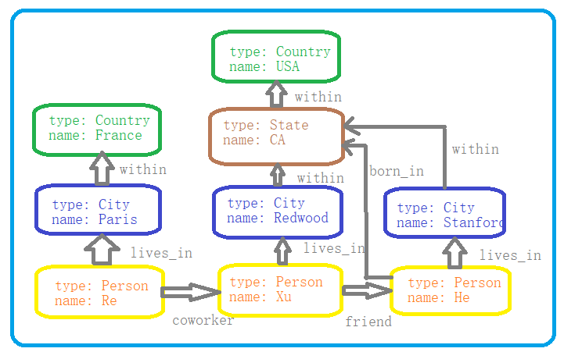
NoSQL(4)
Graph Model
Built around concept of “Graph”
Graph consists of nodes and edges, where edges represents relationship between the nodes
Database that uses graph structures to store its data is graph database
In document database, content of each document is priority
In graph database, relationships between data items are priority!
Faster to retrieve data faster as relationships are models in that way
For example, consider the following representation
that may come from social media
Find person born in USA
Which one is simpler – graph or relational model?

Slide 13
Thank You!
In our next session:

